Slide 1
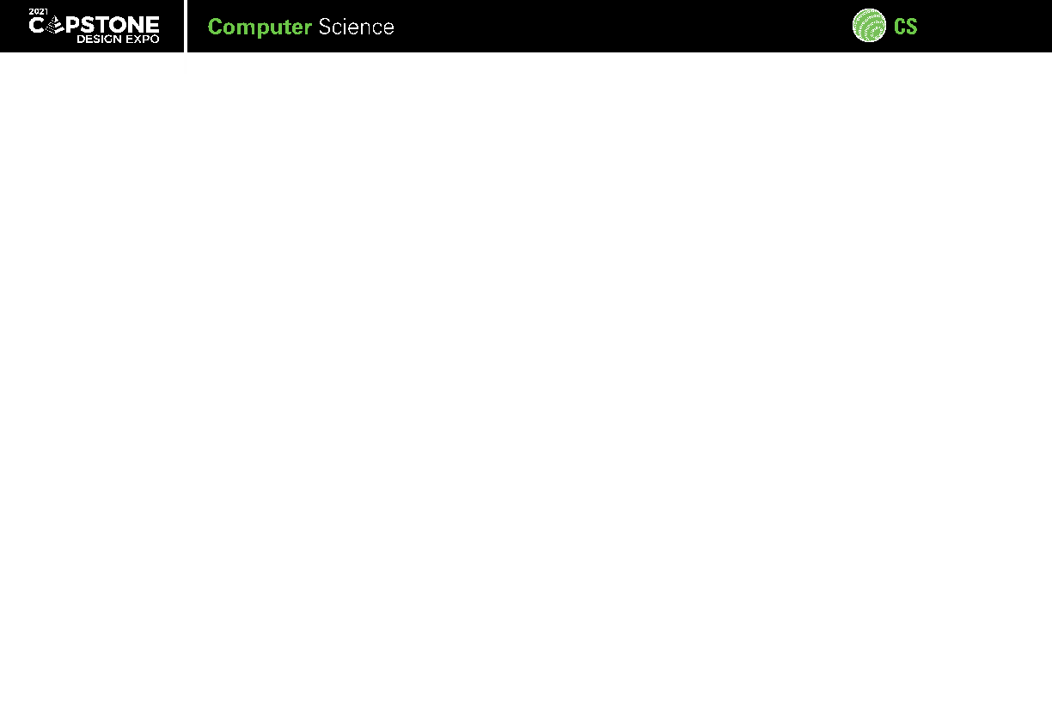



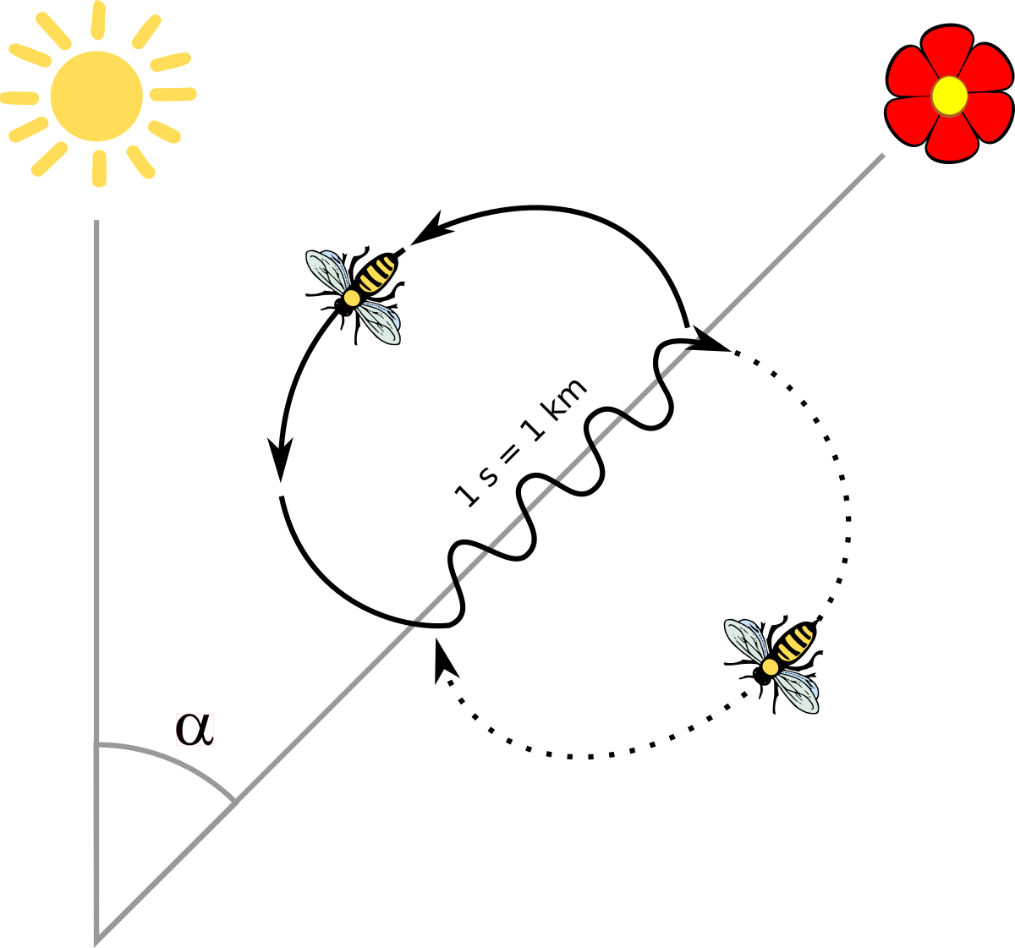
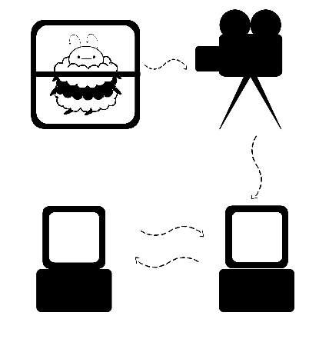
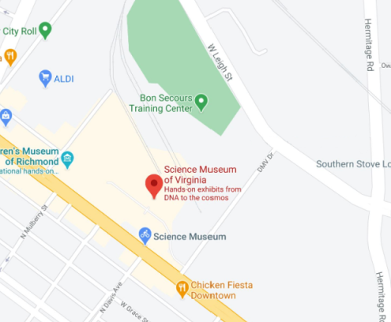






21-303
Honey Bee Dance Language Translator App
What’s the Buzz: Science Museum Of Virginia Uses Artificial Intelligence to Analyze Bee Videos to Determine their Pollen Sources
Team members: Chelsea Greco, Paul Cochran, Vinit Patel, Christopher Flippen | Faculty advisor: Robert Dahlberg | Mentor: Jeremy Hoffman | Sponsor: Science Museum of Virginia
It’s a Dance Battle
Do the Waggle
WaggL
Sugar, Ah Honey Honey
Bees dance to communicate location of pollen
This dance is called waggling
Bees dance in a figure eight pattern
The angle of the dance to the sun tells the direction of the pollen
The length of the dance tells the distance
A camera records a glass panel observation hive
A laptop stores the videos
The videos are transferred through a remote access tunnel
The videos are analyzed by a waggle detection program
Bee movement is detected
Their paths are traced using image analysis
These paths are analyzed in parallel to find the waggling
A camera controlled by script collects the waggle clips
The clips are mathematically evaluated to identify the angle of waggling
From the data a visualizer and a map display where the bees obtain pollen
Demonstrates:
What kind of honey is being produced
What flowers should be protected for bee consumption
Habits of bee hives and species
Expands research in apiology: the study of honey bees

